Slide 1



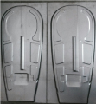
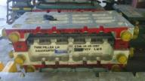
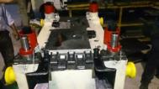
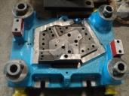
TO EXCELLENT GROUP OF COMPANIES (ISO AGSI Certified company)
2
WELCOME
SECTOR No.07, Plot- 234, PCNTDA, BHOSARI, PUNE- 411026
CONTACT- Mr. Moharsingh Verma (Proprietor) , Mobile No- 9822972350
Mr. Dilip M. Verma Mobile No:- 9763579537
Company Mail ID –npd@excellentdies.com

Slide 2
Quality Policy
AT EXCELLENT GROUP OF COMPANIES, WE ARE
COMMITTED TO ENHANCE CUSTOMER SATISFACTION THROUGH MANUFACTURING OF RIGHT QUALITY TOOLS,
AT RIGHT TIME AND AT COMPETITIVE PRICE .
WE PRACTICES CONTINUAL IMPROVEMENT FOR EFFECTIVENESS OF QUALITY MANAGEMENT SYSTEM.

Slide 3
Excellent Group of Companies
Dear Sir,
We introduce ourselves as a group of Technically Qualified people engages in Designing & manufacturing of Press Tools,Jigs,Fixtures, special tooling & special gauges, gauging fixtures, All types of casting works & laser cutting works also rapid proto type developments and production of sheet metal parts and welded assemblies.
we also have technological expertise in manufacturing these precision items & have skilled hands to bring the appropriate design on paper to practical reality. We have experienced & skilled inspection team to check, inspect & record & there by assure the quality demanded by our esteemed customers. They are well versed & are equipped with adequate equipment & facilities.
We always keep our customer’s need & urgency as our prime importance & plan accordingly for the maximum mutual convenience.
“We assure our client Best of our Efforts, Prompt Delivery, Reasonable Rates & our best services at all times.”
We Now look forward to receiving your valued inquiries soon.
Thanking you in anticipation,
We remain, Sincerely Yours,
Mr. Moharsingh Verma
( Chairman.)

Slide 4
Founders
CHAIRMAN
Mr. Moharsingh Verma : A qualified Mechanical Engineer with experience of over 25 years. He looks after finance and strategy of the company
DIRECTOR
Mr.Deepak verma: A qualified Mechanical Engineer with experience of over 12 years in R&D ,New product development and production work. ( SECOND GENERATION)
DIRECTOR
Mr.Dilip verma: A qualified Mechanical Engineer with experience of over 08 years in R&D ,New product development and production work. ( SECOND GENERATION)

Slide 5
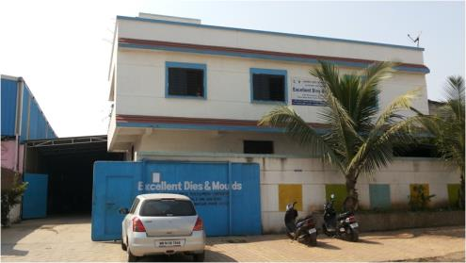
Excellent Dies and Moulds
Specifications -
Factory Area – 20000 Sq ft.
100 HP Electricity Connection Facility.
30000 Litres water storage and connection facility.
Spacious office.
Good location and great connectivity with Pune City and just 15 minutes from Chakan Industrial Area (Auto Hub of India)

Slide 6
Capacity of Manufacturing Tools/Month
Range/Size | Capacity/Month
500 mm to 1000 mm | 30 Tools
1000 mm to 1500 mm | 20 Tools
1500 mm & Above | 10 Tools

Slide 7
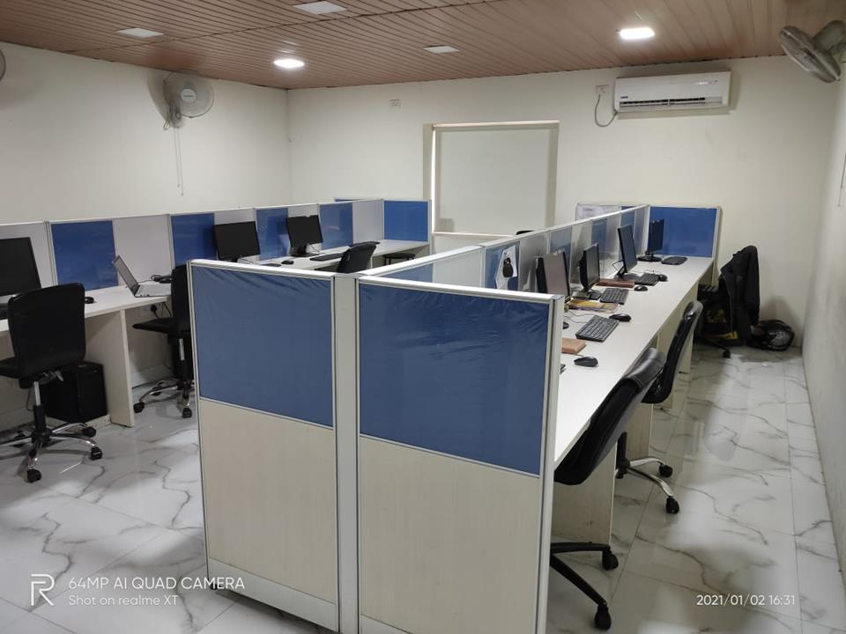
FACILITIES
s
DESIGN CENTER
Inhouse Design Team Strength :-
3D Modeling – 6 People.
2D Drafters – 5 People.

Slide 8
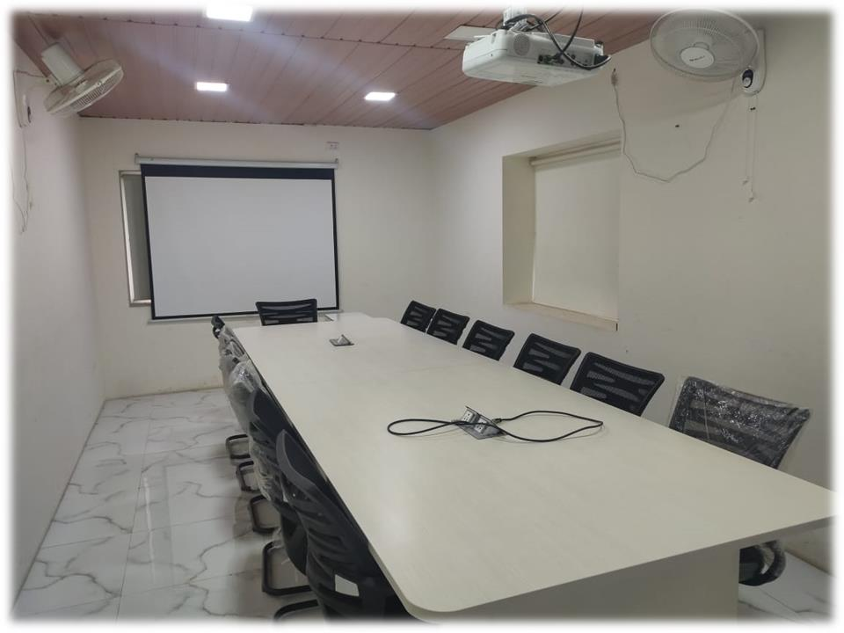
FACILITIES
s
CONFERENCE HALL
WAR ROOM :-
SEATING CAPACITY – 15 PEOPLE
WITH PROJECTOR, HDMI CONNECTION FACILITY

Slide 9
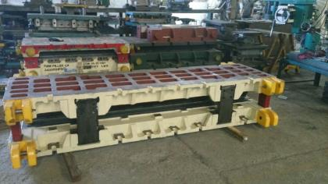
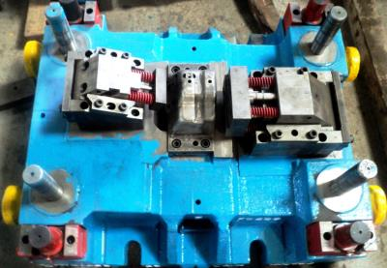
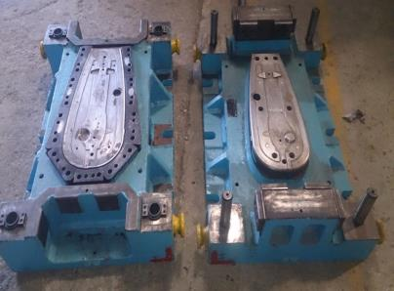

CRITICAL TOOLS DESIGNED AND MANUFACTURED.
TOOLS FOR LOAD BODY CROSS MEMBER (DAIMLER CHENNAI)
TOOLS FOR ENGINE MOUNTING BRKT (BADVE AUTO INDIA)
MAHINDRA 2-WHEELER CHAIN CASE
HISPEED TOOLING

Slide 10
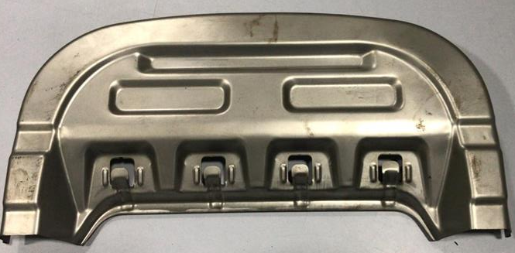
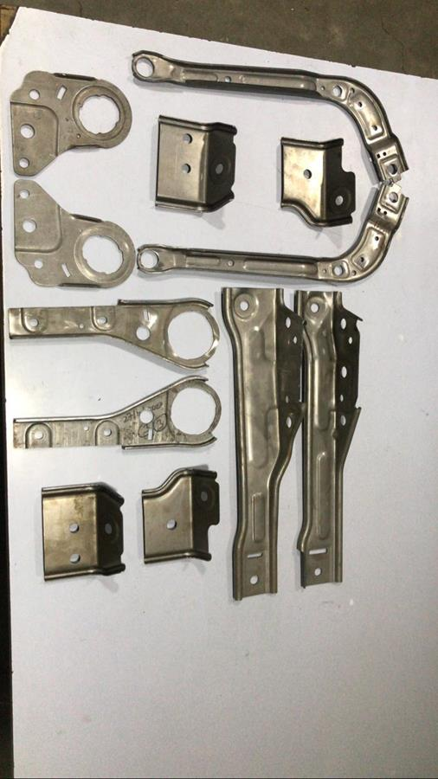
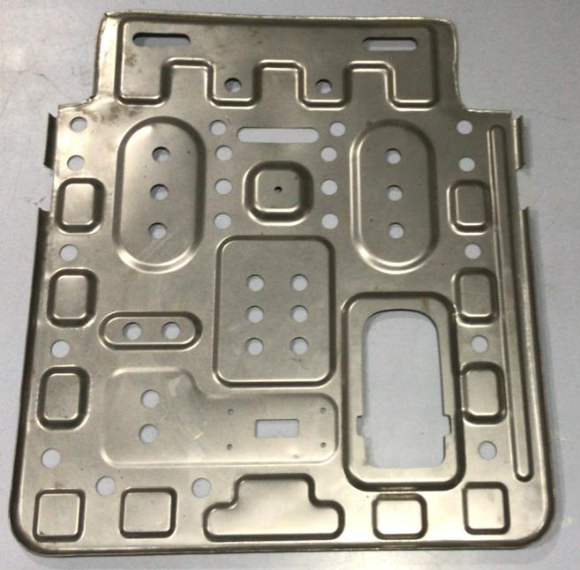
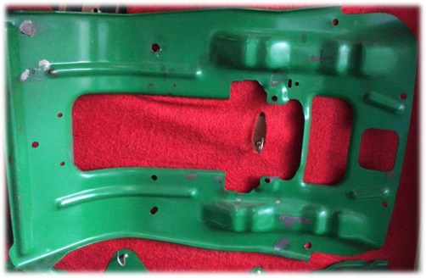
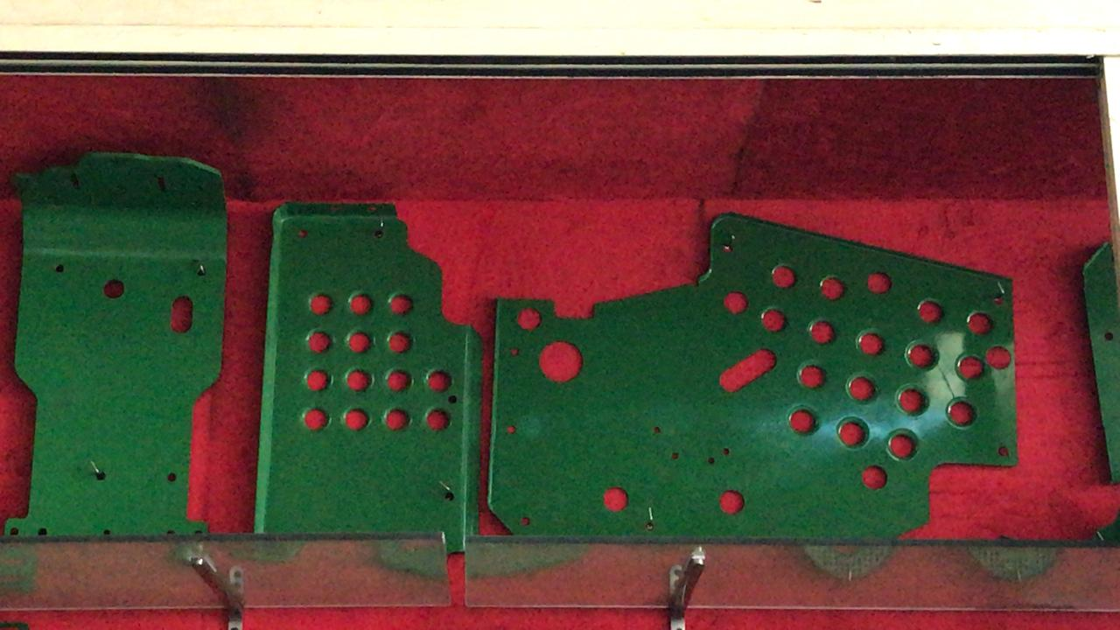
PARTS PRODUCED IN OUR FACILITY
SEAT PAN – DAS AUTO
MATERIAL GRADE – DP780
W601 THIRD ROW – LEAR CORP.
MATERIAL GRADE – QSTE 500 TM
MAHINDRA GENZE 2-WHEELER SEAT FRAME
W601 PAN – LEAR CORP
MATERIAL THK – 0.5MM
MAHINDRA ARJUN TRACTOR

Slide 11
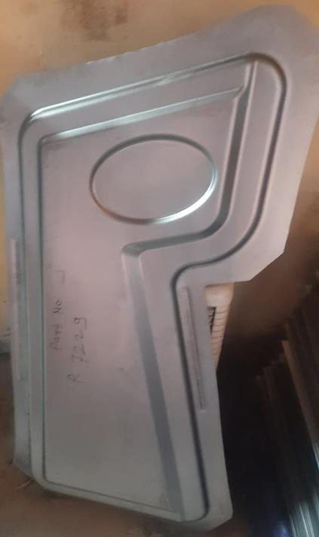
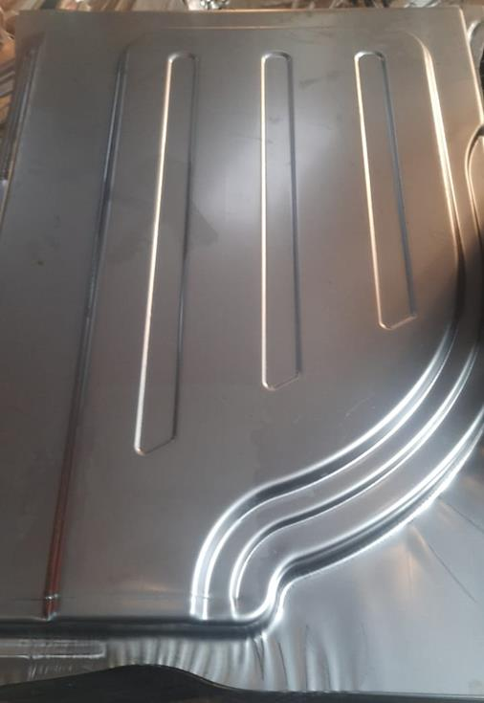
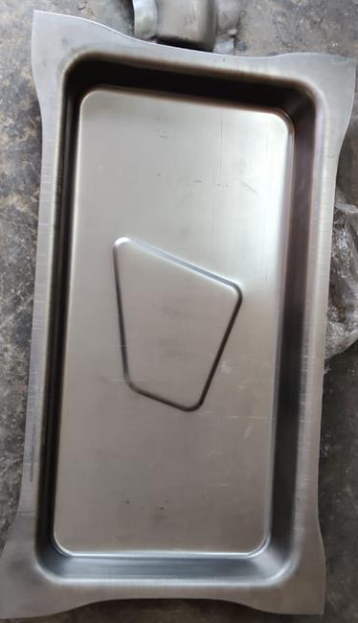
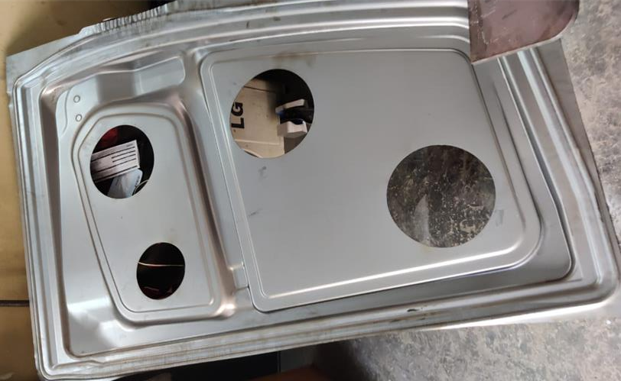
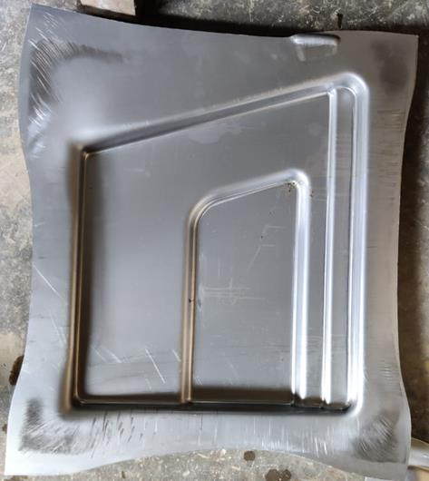
PARTS PRODUCED IN OUR FACILITY
COVER LATCH PANEL – CAPARO
RH PANEL - CAPARO
TOP HATCH PLATE - CAPARO
DOOR INNER –
CAPARO
RH PANEL FRONT-
CAPARO

Slide 12
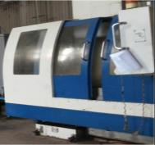
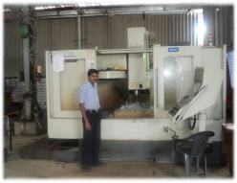
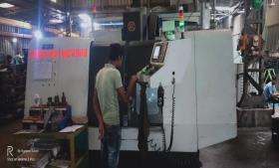
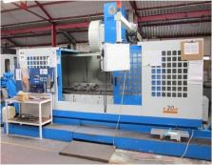
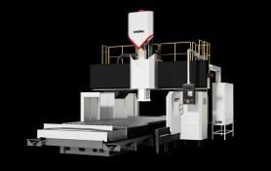
MACHINING FACILITIES
VMC MAKE – KAFO
VMC MAKE – HARTFORD
VMC MAKE – CHEN-HO
BED SIZE - 800 X 1300 X 600
BED SIZE – 600 X 1100 X 600
BED SIZE – 900 X 400 X 500
VMC MAKE – LEAD TAKUMI
TOTAL NO OF VMCs – 06 NOS
VMC MAKE – HISION
BED SIZE - 1000 X 2000 X 800
BED SIZE – 1500 X 800 X 700

Slide 13
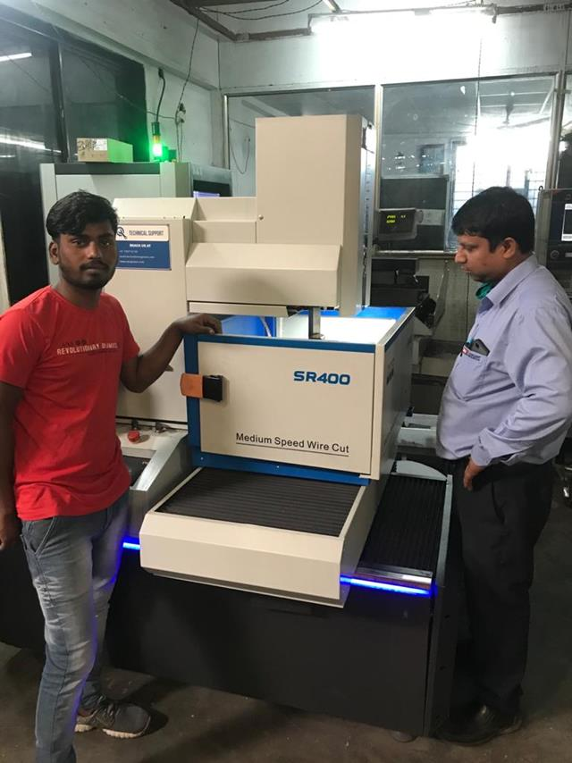
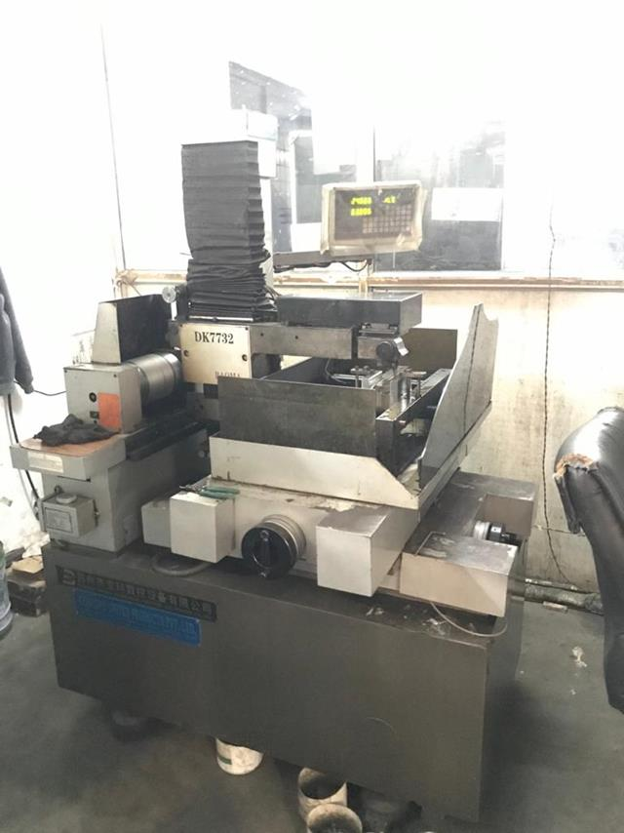
PRODUCTION FACILITIES
EDM Wirecut Machines
Specifications -
Make – Electronica and Sodick
Qty – 2 Nos.
Bed size – X (400) , Y(400) , Z(600)
(All Dimensions in mm.)

Slide 14
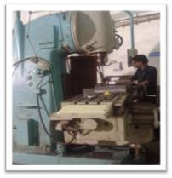
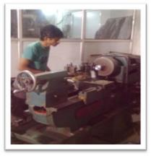
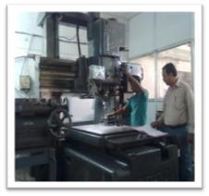
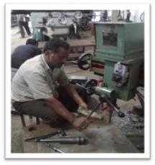
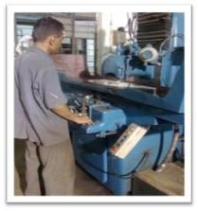
PRODUCTION FACILITIES
MILLING M/C (BIG SIZE)
LATHE M/C
JIG BORING M/C (SIZE-1200X1000X600)
MACHINE QTY – 04 NOS
MACHINE QTY – 02 NOS
MACHINE QTY – 02 NOS
DRILLING M/C
SURFACE GRINDING M/C
TOTAL NO OF MACHINES – 16 NOS
MACHINE QTY – 06 NOS
MACHINE QTY – 02 NOS

Slide 15
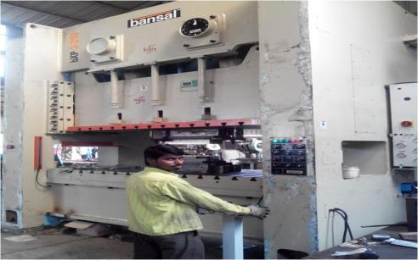
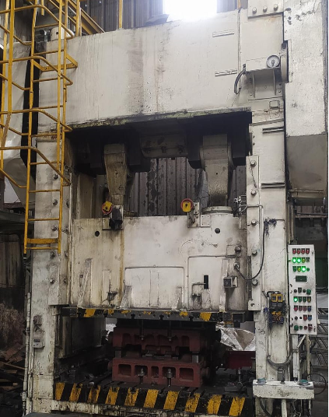
SHOPFLOOR VIEW
PNEUMATIC PRESS 300 Ton
PNEUMATIC PRESS 500 Ton
Specifications -
Specifications -
Make – BANSAL MACHINERIES
Double Column specially customised machine.
Bed size – X (1000) , Y(2000) , Z(600)
(All Dimensions in mm.)
TOTAL 5 NOS OF PRESSES FOR TRIAL
Make – AIDA
Double Column specially customised machine.
Bed size – X (1000) , Y(2000) , Z(600)
(All Dimensions in mm.)
TOTAL 5 NOS OF PRESSES FOR TRIAL

Slide 16
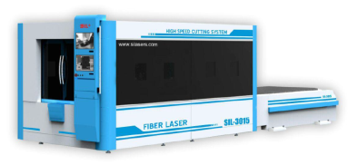
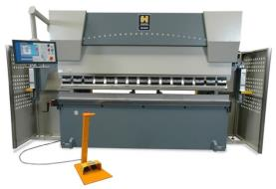
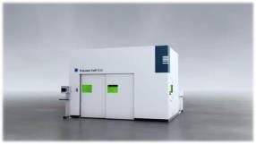
PRODUCTION FACILITIES
2 AXIS LASER CUTTING
CNC PRESS BRAKE
MACHINE MAKE – SIL
BED SIZE – 1500 X 3000MM
MAX CUTTING CAPACITY –
MS – UPTO 12 MM
SS – UPTO 6 MM
ALUMINIUM – UPTO 4 MM
MACHINE MAKE – HACO
BED SIZE – 3000MM
MAX BENDING CAPACITY –
MS-5MM UPTO 3000MM
5 AXIS LASER CUTTING
MACHINE MAKE – TRUMPF 5 AXIS LASER CUTTING
LASER TYPE – FIBER LASER
BED SIZE - 1500 X 3000 MM

Slide 17
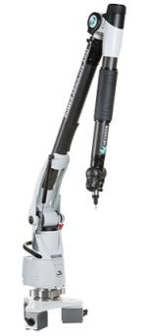
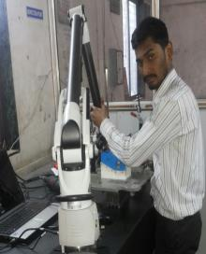

QUALITY FACILITIES
INSPECTION ROOM
Features -
Strong and Reputed Brand (Hexagon Metrology), far better than FARO.
1.2 metre Radius Coverage.
Strong Accuracy ranging from 10-12 microns.
Machines available for On-site Inspection in any region of the Country.
Services available on a Pan India Presence.
Expanding our operations and services, we’ve added a new machinery to our arsenal. The Romer Absolute Arm made by Hexagon Metrology Inc. USA. We pride ourselves on providing CMM services with our new machine in addition to various other services including 2D and 3D Fixture Inspection, Welding Fixture Adjustments, Reverse Engineering with Documentation, 3D digitizing, 3D modelling, rapid prototyping. This system is an all-purpose metrology tool for a multitude of applications. Portable with high accuracy makes it very convenient to use as since we can install and start using it anywhere.

Slide 18

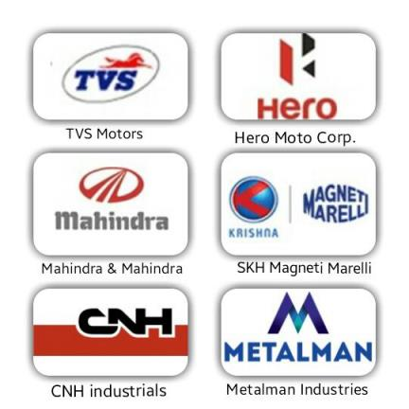
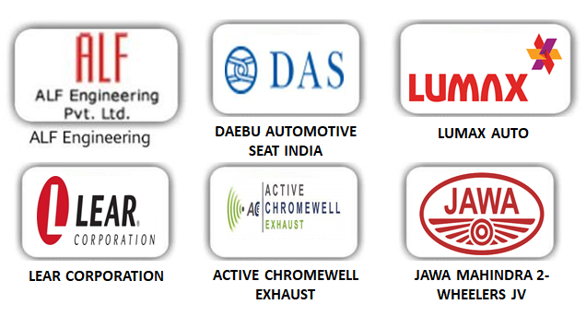

Our customers
CAPARO ENGG

Slide 19


EXCELLENT LASERTECH & PROTO.(GROUP COMPANY)
(ISO AGSI Certified company)
SECTOR No.07, Plot- 197, PCNTDA, BHOSARI, PUNE- 411026
Mr. Deepak Verma
Mr. Moharsingh Verma,
Mobile No-+917798987987 Mobile No - +919822972350
Company Mail ID – marketing@excellentproto.com
excellentlasertech@gmail.com

Slide 20

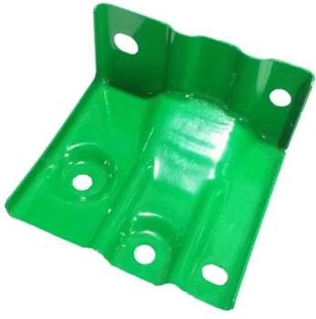
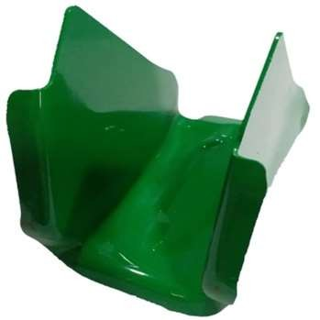
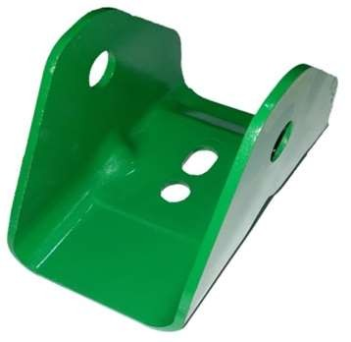
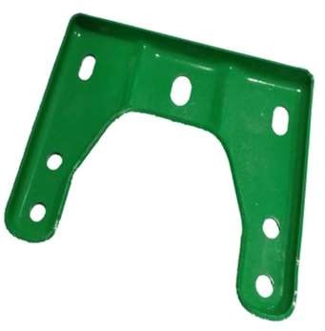
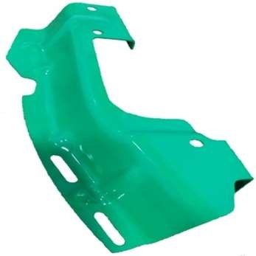
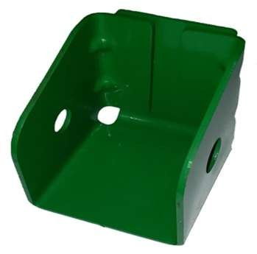
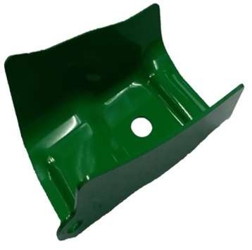
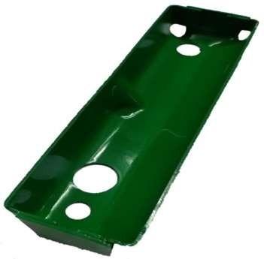
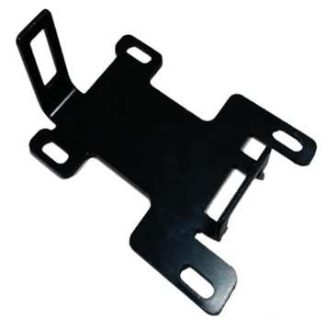



PROTO PARTS DEVELOPED.

Slide 21



➢PRODUCTION FACILITIES
2D LASERCUT MACHINE
CNC PRESS BRAKE
5-AXIS LASERCUT MACHINE
Specifications -
Specifications -
Specifications -
Make –SIL 2KW FIBRE OPTIC LASER & 6KW FIBRE OPTIC LASER 2QTY
Cutting Capacity – MS – Upto 10mm
SS – Upto 5 mm
Bed size – 3000MM X1500MM
(All Dimensions in mm.)
Make – HACO Brazil
Bending Capacity – MS – Upto 12mm
SS – Upto 8mm
Bed Length – 3000MM
(All Dimensions in mm.)
Make – Trumpf Germany
Bed size – 3000MM X
1500MM X 800MM
(All Dimensions in mm.)

Slide 22

➢PRODUCTION FACILITIES
WELDING MACHINES
Specifications -
Make – SUDARSHAN CO2 WELDING
CURRENT – 250 AMP
QTY – 05 NOS

Slide 23










OUR CUSTOMERS

Slide 24


TO QUALITY CASTINGS.(GROUP COMPANY) (ISO AGSI Certified company)
WELCOME
Manufacturers of Ferrous Castings, CI Castings, SG Iron Castings, Press Tool Castings, Thermocol Patterns, Machining of Castings
Address – Plot No. PAP-94/2B, MIDC CHAKAN INDUSTRIAL AREA (PH-2), TALUKA KHED, PUNE- 410501
CONTACT- Mr. Dilip Verma (Director) , Mobile No- 9763579537
Mr Pradeep Sutar.( Plant head/ Business head). 9766522169
Company Mail ID – qualitycasting2023@gmail.com

Slide 25

Manufacturing Plant
Specifications -
Factory Area – 30000 Sq ft.
150 HP Electricity Connection Facility.
30000 Litres water storage and connection facility.
Spacious office.
Good location and great connectivity with Pune City and just 2 minutes from GE Industrial.

Slide 26

FACILITIES
s
FOUNDRY MACHINE
Machine Specification :-
Total Production Capacity – 250 Tons Per Month

Slide 27

FACILITIES
s
SAND BLASTING MACHINE
Machine Specification :-
Qty – 2 Nos

Slide 28

FACILITIES
s
LADLE MACHINE
Machine Specification :-
Qty – 2 Nos
Capacity – 3 Tons and 5 Tons

Slide 29
FACILITIES
s
LADLE MACHINE
Machine Specification :-
Qty – 2 Nos
Capacity – 3 Tons and 5 Tons

Slide 30




CASTING MANUFACTURED AT OUR PREMISES FOR YOUR REFERENCE.
Material Grade Capability :-
FG260, FG300, M15

Slide 31
Future expansion plan of year 2025-2026.
This presentation outline our future plan to establish a state of the art sheet metal stampings and welding facilities in chakan .
We are having 1.10 acres owned land in chakan for the future planning of estabilishing the stampings and welded assemblies plant.
We are continuously working on our mission and vision of making the one stop solution company for our customers.

Slide 32


